Slide 1
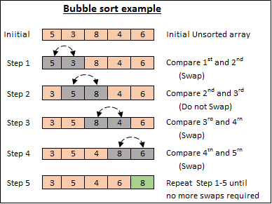
Standard Algorithms Sorting Algorithm 1: The Bubble Sort
Complete the steps to sort the array
Step 5 | 3, 5, 4, 6, 8
Step 6 | 3, 4, 5, 6, 8
Step 7 | Check it over 3, 4, 5, 6, 8

Slide 2
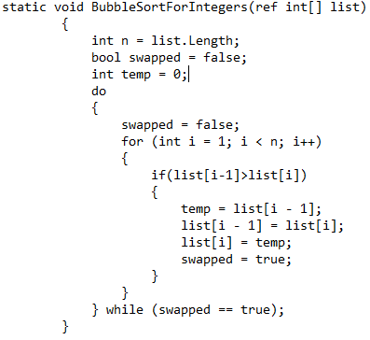
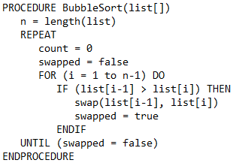
Standard Algorithms Sorting Algorithm 1: The Bubble Sort
Example Pseudocode for: A bubble sort | Example C# instructions for: A bubble sort
Stages of a Bubble Sort (Describe) Start with 1st 2 elements – set swap to false Compare 2 elements and sort them into ascending order by swapping them if needed If swap has occured set swap to true – a repeat is needed Repeat step 2 and 3 for all elements in the array Steps 1 to 5 are repeated until no swaps are required – swap == false | Advantages of a Bubble Sort Takes 1 iteration to check if array is already sorted Easy to understand as values are compared and swapped if needed, then repeated.
 | Disadvantages of a Bubble Sort

Slide 3

Bronze 1
Exam Questions
A bubble sort can be used to sort the values in the array shown above. Show each of the stages that a bubble sort would perform in order to sort the array (above) into numerical order starting with the lowest value Write below [3 mark]
2,1,9,8,5 1,2,9,8,5 1,2,8,9,5 1,2,8,5,9 1,2,5,8,9,
Describe how a bubble sort can be used to sort data into ascending order Write below [6 mark]
Start with 1st 2 elements – set swap to false Compare 2 elements and sort them into ascending order by swapping them if needed If swap has occured set swap to true – a repeat is needed Repeat step 2 and 3 for all elements in the array Steps 1 to 5 are repeated until no swaps are required – swap == false

Slide 4
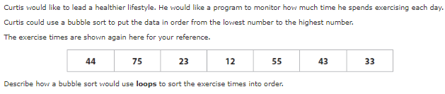
Silver 1
Exam Questions
Write below [4 mark]
Make use of 2 loops Loops are nested Inner loop will iterate code a set number of times To check adjacent value and swap if it is needed

Slide 5
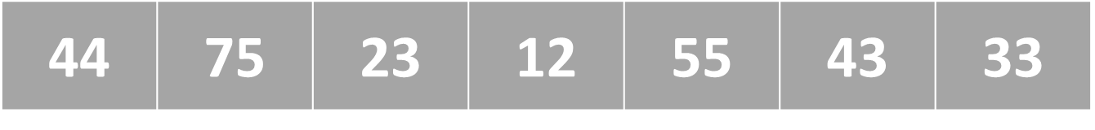
Silver 2
Exam Questions
Describe how a bubble sort can be used to sort data in the array (shown above) into ascending order. (You must show each stage of the iterative process) Write below [8 marks]
Bubble sort can be used to put the algorithm into ascending order 44, 75, 23, 12, 55, 43, 33 – starting from unordered. 44, 23,12,55,43,33,75 23,12,44,43,33,55,75 12,23,43,33,44,55,75 12,23,33,43,44,55,75

Slide 6
Gold 1
Exam Questions
A bubble sort can be used to sort the values in the array. Explain two advantages and two disadvantages of using a bubble sort to sort data into ascending order Write below [8 mark]
•Advantages: It only takes one iteration to detect that the data collection is already sorted. Relatively easy to understand as values are simply compared and swapped if needed. This process is repeated until the data collection is sorted. •Disadvantages: Can be inefficient for large collections of data because every pair combination must compared. The larger the data collection the longer the algorithm will take to complete. Can be inefficient as a final/ additional iteration is usually needed to confirm that the collection has been sorted.

